Slide 1


Sustainable Urban Transport: Optimising Traffic Flow, Safety and Carbon Emission on an Urban Highway Corridor of Bangladesh
Research Title
HUSSEIN MD TANVEER
M250436
HIROSHIMA UNIVERSITY

Slide 2
Research objectives:
To evaluate the performance regarding efficiency, safety and emission of the highway corridor.
To optimise the efficiency, safety and emission parameters.

Slide 3
Research inspiration
What an urban highway should cater primarily?
Mobility for transit vehicles?
or
Accessibility and mobility for urban commuters?

Slide 4
Why an Urban Highway Corridor?
In Bangladesh, most of the delays occur in the built up sections of any highway corridor.
The need to traverse the corridor due to economic activities, augmented by the cultural behaviour of pedestrians and vehicle movement disrupt traffic flow

Slide 5
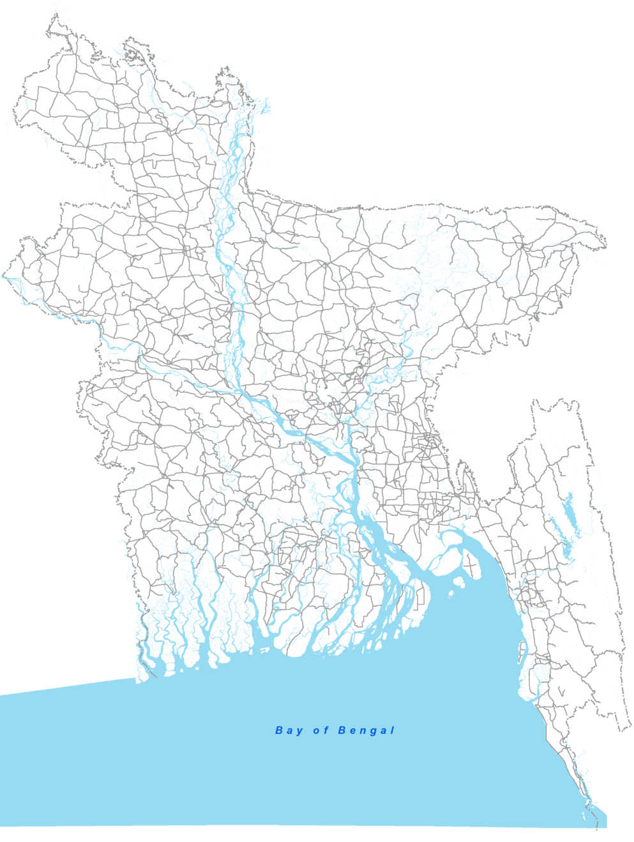
Location of the proposed
highway corridor

Slide 6

Location of the proposed
highway corridor

Slide 7
Video of Highway

Slide 8
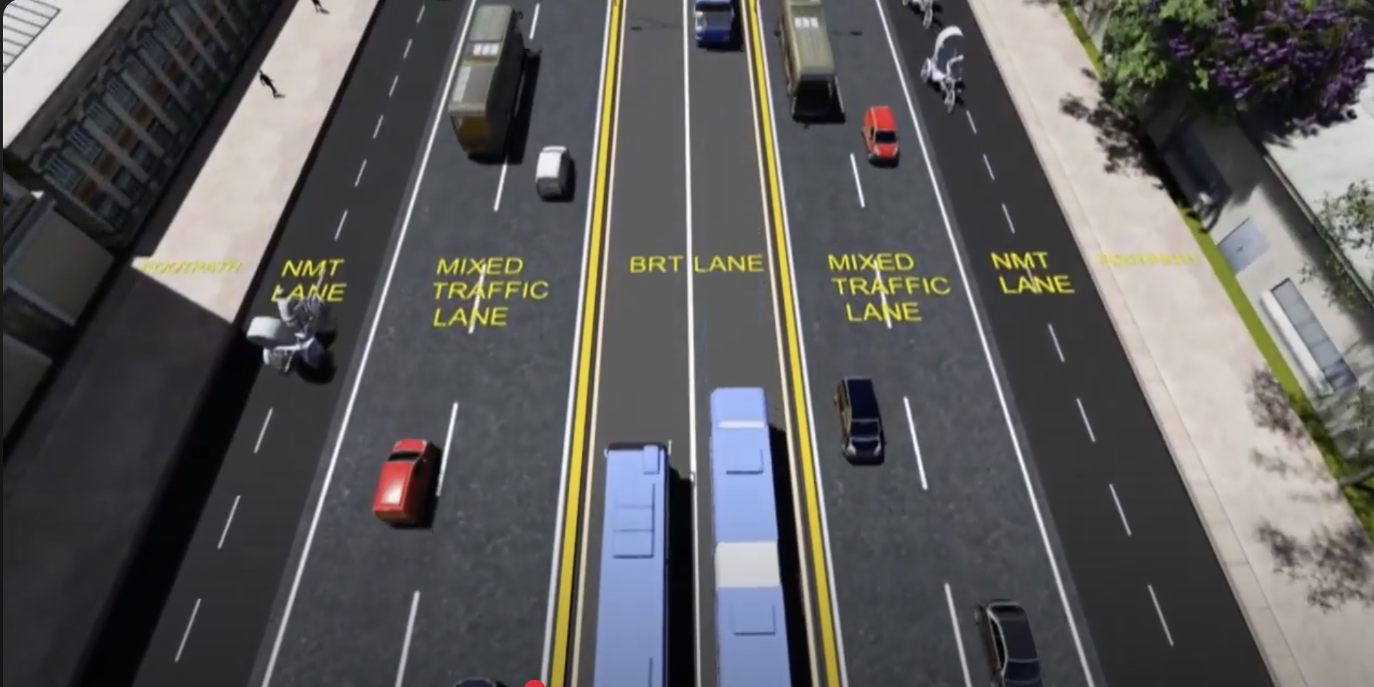

Slide 9
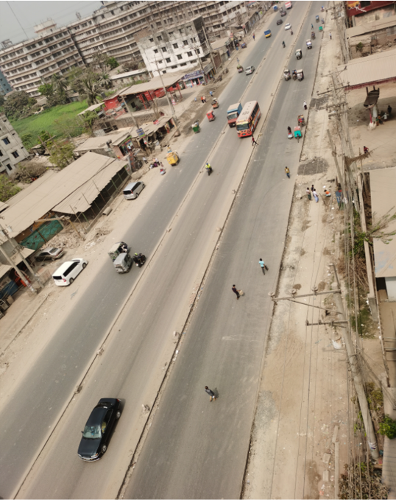
Present condition

Slide 10
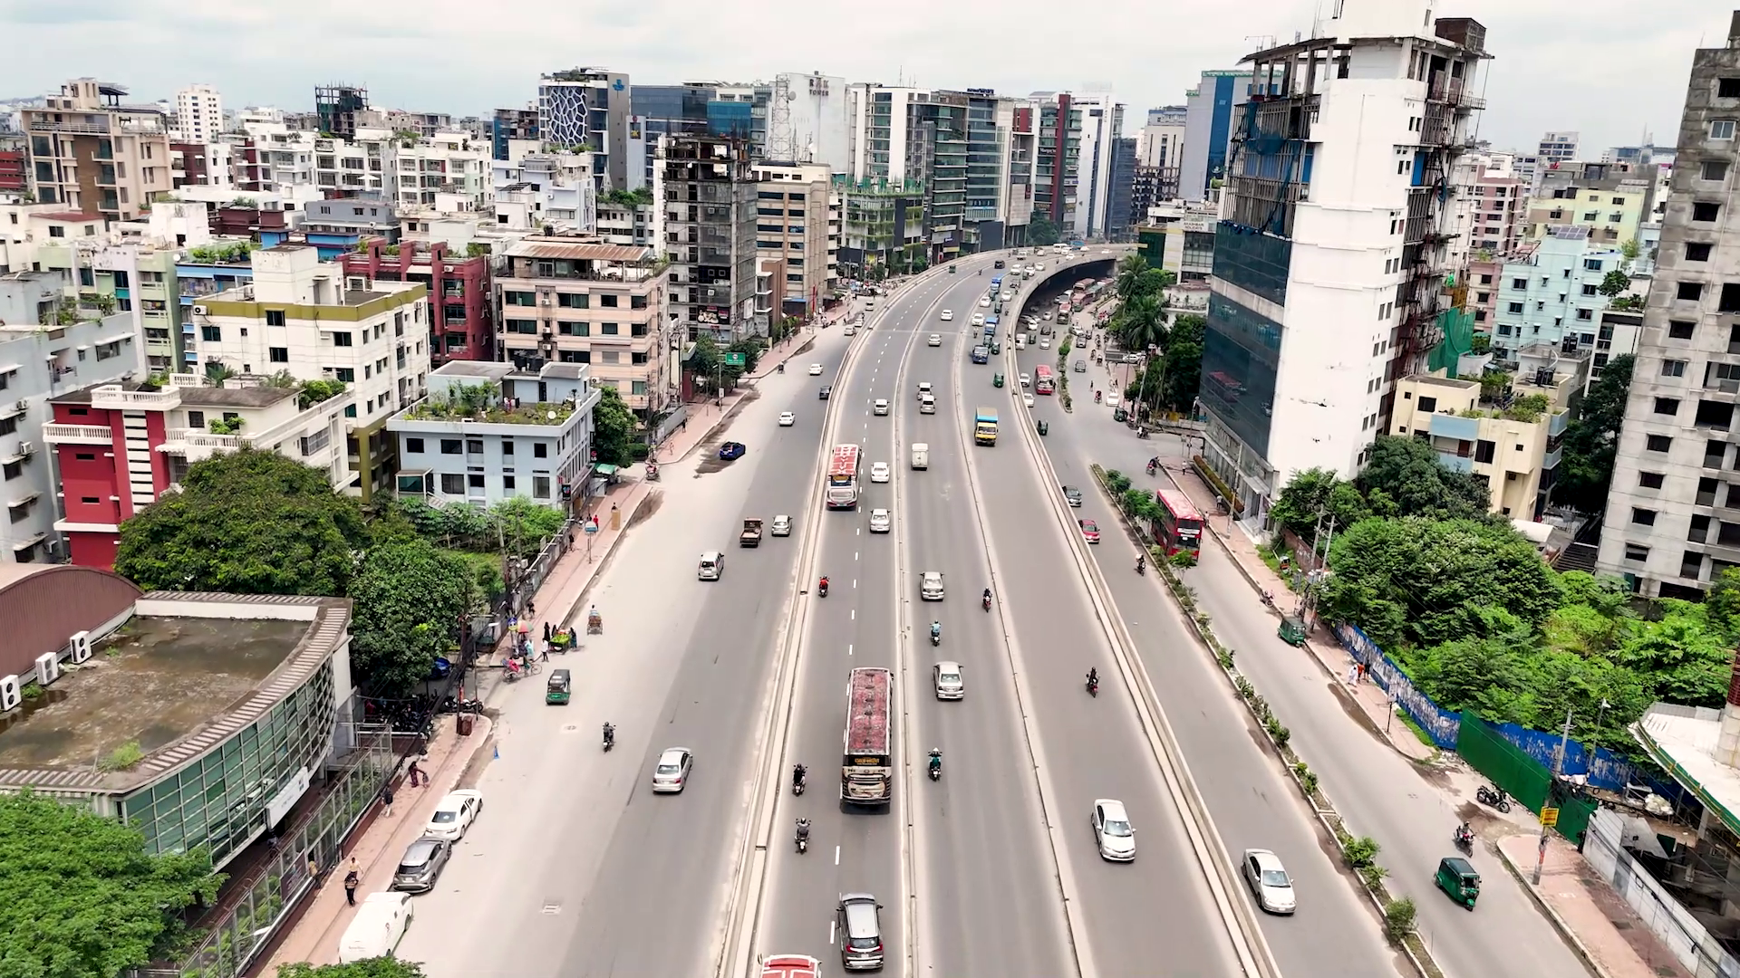
Present condition

Slide 11
What to measure?
Baseline data
Traffic flow: Delay, Level of Service
From real time data by video surveillance
Traffic Safety: time to collision (TTC), modified time to collision (MTTC), and headway
By applying surrogate safety measures
Emission: GHG emission/ fuel consumption
From vehicle speed and emission rate

Slide 12
Optimisation between scenarios
After selecting a suitable section representing the corridor, a simulation model will be developed with VISSIM software. After the model is validated, another model will be created by introducing an HOV lane instead of the BRT lane
Finally, this research will optimise the efficiency, safety and emission parameters to drive a sustainable shift towards a smart city.
For forecasting purposes, the model will be analysed for different scenarios representing different geometric configurations and time intervals. A multi-criteria decision analysis, such as Genetic Algorithm (GA) or Non-dominated sorting genetic algorithm II (NSGA-II) , may be applied to optimise efficiency, safety, and emissions.

Slide 13
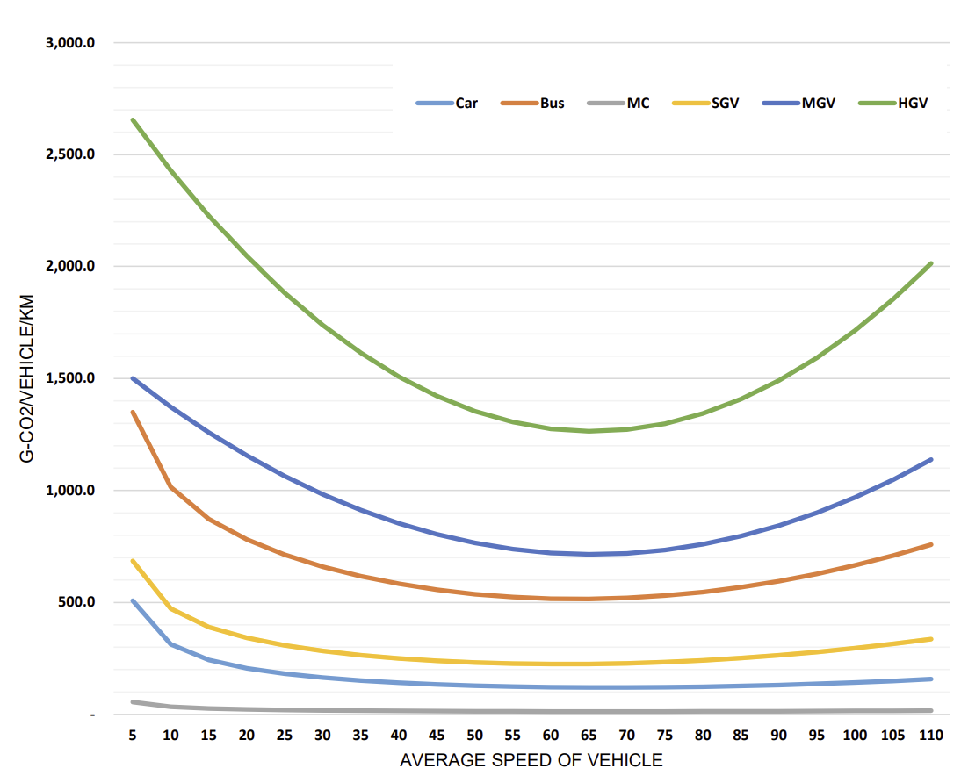
Base Emission Factors by Vehicle Type
Measuring Emission
The relationship between vehicle speed and emission rate, as measured by the Public Works Research Institute of Japan (PWRI)
Source: Bangladesh Highway Masterplan 2041

Slide 14
Conclusion

Slide 15
Comment from Previous Meetings:
Reem san:
Start reading papers/articles on relevant topics, to decide on the parameters you want to measure
Scope of the research is too wide to be covered within the duration of a Master course
Azis san:
Focus on Safety analysis part involving Traffic Conflict Technique (Surrogate Safety Measures).
Start learning to work on the Simulation software (PTV-Vissim)

Slide 16
Papers on Traffic Flow
Title | Author | Parameters | Method
A real-time computer vision sysrem for vehicle tracking and traffic surveillance | Coifman et al | Traffic Count, Density, Speed | Feature based tracking
Traffic flow estimation with data from a video surveillance camera | Federov et al | Traffic Count | SSD
Vision-based vehicle detection and counting system using deep learning in highway scenes | Huansheng et al | Traffic Count | YOLOv3

Slide 17
Papers on Traffic Safety
Title | Author | Parameters | Method
A bivariate, non-stationary extreme value model for estimating opposing-through crash frequency by severity by applying artificial intelligence-based video analytics | Howlader et al | Gap time (GT), TTC, PET | YOLOv3, Deep SORT
Spatial–Temporal Video Analysis For Advanced Traffic Conflict Detection And Risk Assessment Using Yolov8 And Attention-Enhanced Safety Metrics | Singh et al | TTC, PET, DRAC | YOLOv8, Deep SORT
An automated surrogate safety analysis at protected highway ramps using cross-sectional and before–after video data | Paul et al | TTC | Feature based, Traffic Intelligence

Slide 18
Thank you

